Slide 1
CSE 220
Data Structures
Lecture 00: Introduction

Slide 2
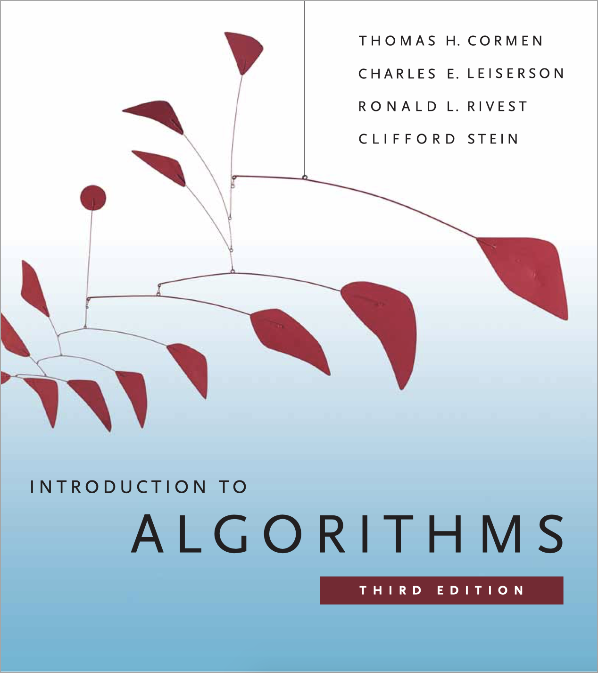
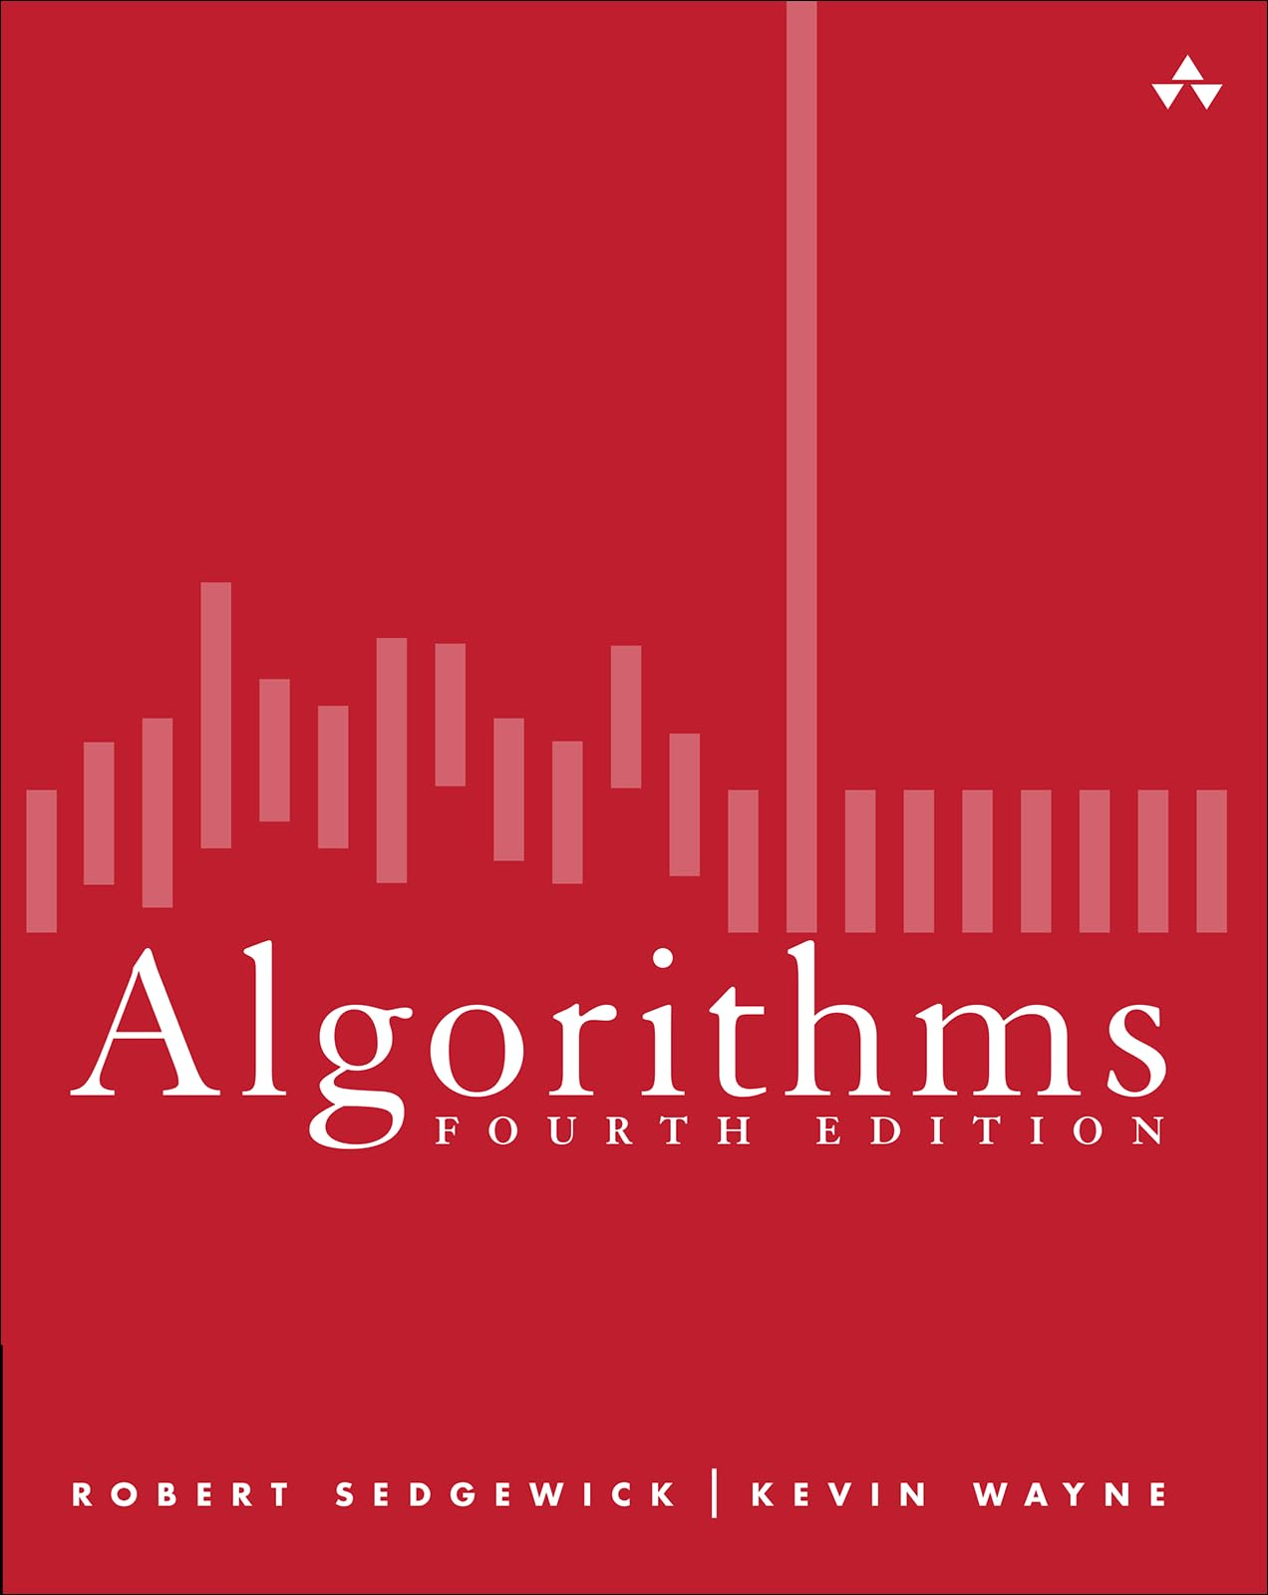
Reference Books
Algorithms, 4th Edition by Robert Sedgewick and Kevin Wayne
Introduction to Algorithms (Third Edition) by Thomas H. Cormen, Charles E. Leiserson, Ronald L. Rivest, and Clifford Stein

Slide 3
Class Information
This is a 3 credit course
So, there will be 3+1 = 4 quizzes
Out of these, best three will be selected

Slide 4
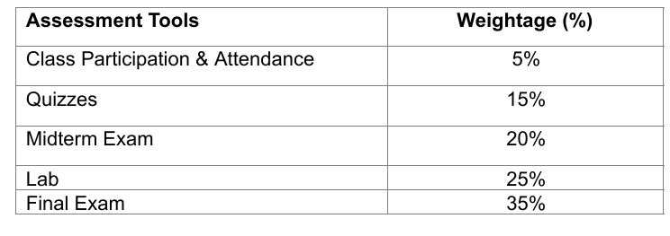
Mark Distribution (May Change Later)

Slide 5
Contact Information
Desk 4M112
anwarul.bashir@bracu.ac.bd

Slide 6
Prerequisites
Java concepts (start revising!)
  Class, methods, fields, objects, public/private access modifiers, inheritance, interface
Array creation, traversal, 1D & 2D arrays
https://forms.gle/u1zvA7ezXAJod9eYA

Slide 7
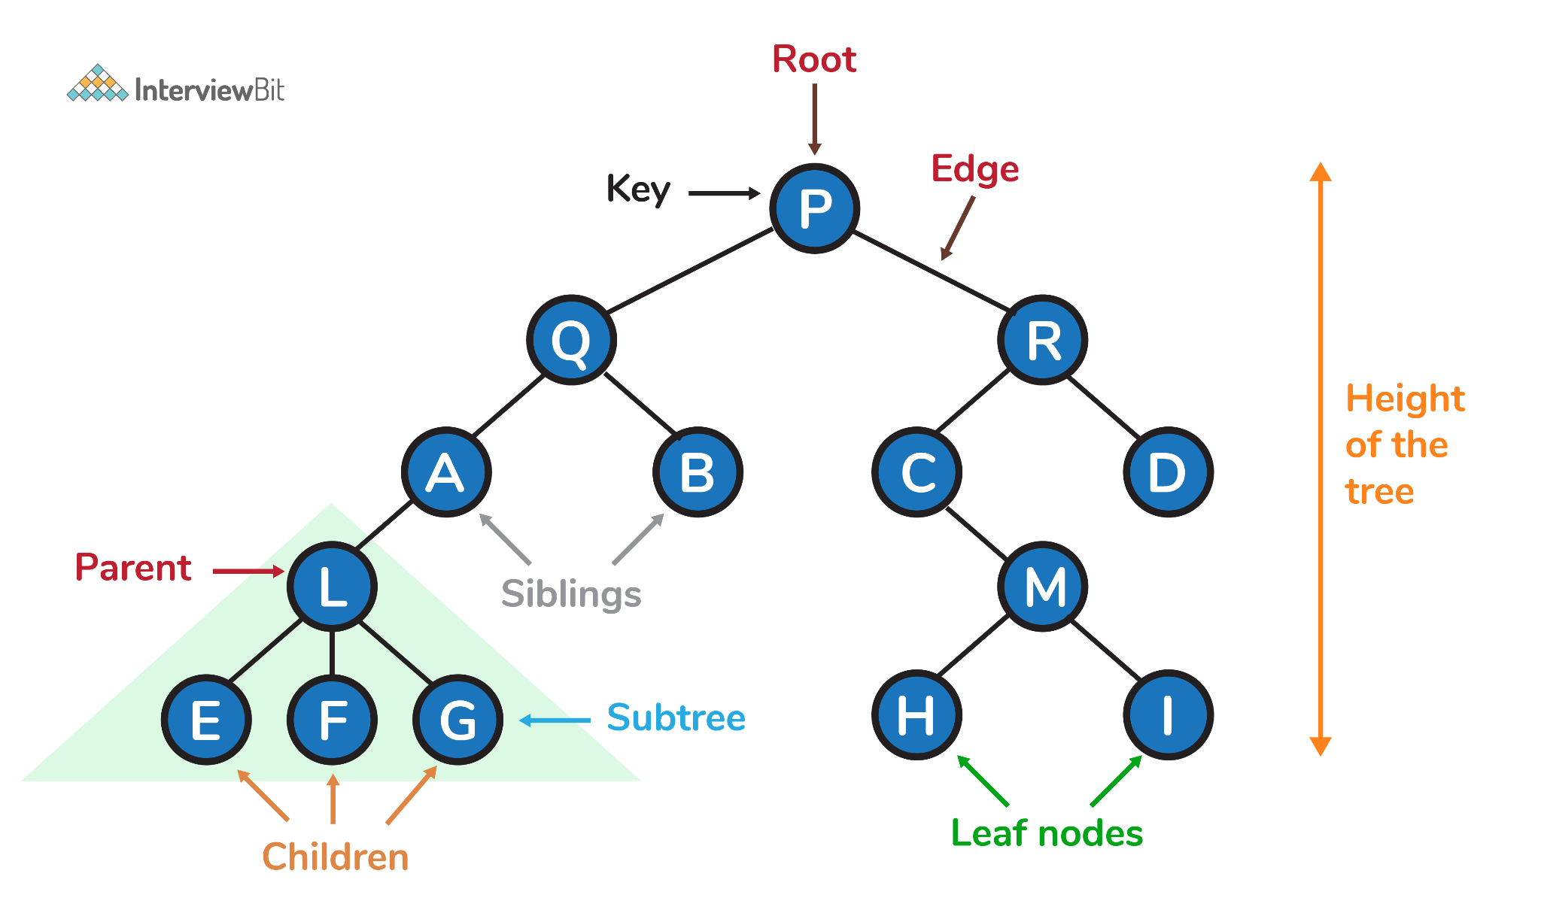
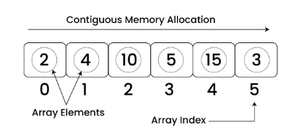
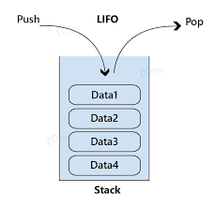
Why Data Structures?
As we write programs, we will need to store, retrieve, modify or delete data frequently.
We want these operations to be as efficient and as fast as possible
A data structure is a way of organizing and storing data so it can be used efficiently. Examples include arrays, lists, stacks, and trees.

Slide 8
Java Review
https://drive.google.com/file/d/1_g4HU6aAXMEssi_ALG0Uh7G9MfYlpo22/view?usp=sharing
We will use IntelliJ IDEA for our Java IDE
VSCode will work as well

Slide 9
Java Review
Concept | Description | Example
Class | Blueprint for objects | class Car {}
Fields | Variables inside a class | int speed;
Methods | Functions inside a class | void displayInfo() {}
Object | Instance of a class | Car car1 = new Car();
Public | Accessible anywhere | public void show()
Private | Accessible within class only | private int age;
Inheritance | One class acquires another’s properties | class Dog extends Animal {}
Interface | Contract for classes to implement | interface Vehicle {}

Slide 10
Resources
https://www.youtube.com/watch?v=Qmt0QwzEmh0&list=PLDV1Zeh2NRsB6SWUrDFW2RmDotAfPbeHu
  Excellent explanation and visualization
  Contains almost all the topics we will teach in this course
https://www.youtube.com/@abdul_bari/videos
You will find almost all the topics of this course (+algorithms) in these two channels

Slide 11
Resources
https://algs4.cs.princeton.edu/home/
  Created by the authors (Robert Sedgewick, Kevin Wayne)
https://www.coursera.org/learn/algorithms-part1
https://www.coursera.org/learn/algorithms-part2
  Both are completely free!
  Amazing lectures by the authors!

Slide 12
Java Resources
https://www.w3schools.com/java/
https://www.youtube.com/watch?v=23HFxAPyJ9U&list=PLZPZq0r_RZOOj_NOZYq_R2PECIMglLemc

